Slide 1
ML Assignment Use Case
5. Regression Model with Feature Engineering + Regularization
Objective: Build a strong regression model with engineered features.
Tasks
Choose dataset (house prices, energy efficiency, etc.).
Perform feature engineering:
Polynomial features
Interaction terms
One-hot encoding
Train:
Linear Regression
Ridge
Lasso
ElasticNet.
Compare overfitting behavior & coefficient shrinking.
Write a summary of which model generalizes best.

Slide 2
Project Objective
Goal: Predict housing prices using complex features.
Method: Feature Engineering + Regularization.
Models: Linear, Ridge, Lasso, ElasticNet.

Slide 3
Regression Model with Feature Engineering + Regularization
1.Dataset Selection:
We selected the California Housing dataset. This dataset includes metrics like median income, house age, and average rooms to predict the target variable: MedHouseVal (Median House Value).
2.Feature Engineering (Making the data "smarter"):
We didn't just use the raw numbers; we created new features to help the model learn complex patterns:
Binning & One-Hot Encoding: We took the numerical Latitude, grouped it into "Zones" (North, Central, South), and converted these into binary (0 or 1) columns so the model could understand geographic regions.
Polynomial Features: We squared the existing numbers (degree 2) and multiplied them together (interactions). This allows the model to see non-linear relationships, like how income combined with house age affects price.
3.Model Training (The Learning Phase):
We trained four specific regression models to see which strategy worked best:
Linear Regression: The standard model. It tries to fit the data perfectly without restrictions.
Ridge ($L_2$): Penalizes the model if it uses very large coefficients (weights), which helps prevent overfitting.

Slide 4
Lasso ($L_1$): Penalizes the model harder, forcing some coefficients to become exactly zero. This essentially deletes useless features.
ElasticNet: A mix of both Ridge and Lasso.
4.Evaluation & Comparison:
We tested the models on data they had never seen (the Test Set) to check for "generalization".
We looked at Test MSE (Lower is better) and $R^2$ Score (Higher is better).
We also plotted the coefficients to visually see how Ridge and Lasso "shrank" the importance of certain features compared to standard Linear Regression.
5.Final Conclusion:
The Standard Linear Regression model won. It had the lowest error (0.5120) and highest accuracy score (0.6093), proving that for this specific feature set, the regularization methods (Ridge/Lasso) were not strictly necessary.

Slide 5
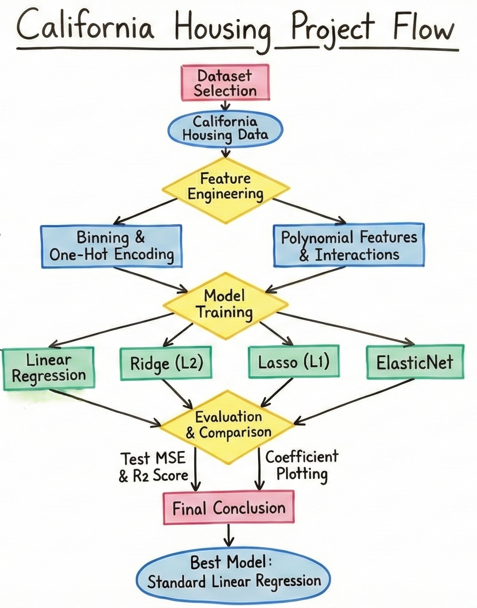
Design Flow Diagram

Slide 6
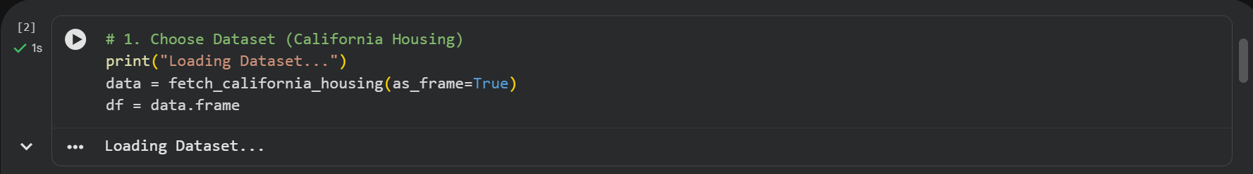
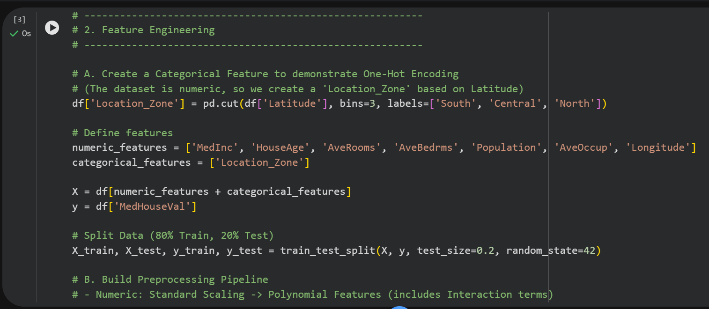
Dataset Selection & Feature Engineering

Slide 7
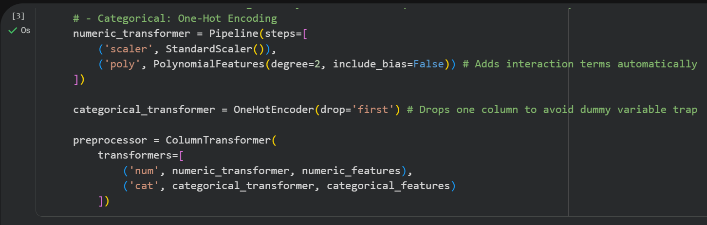

Slide 8
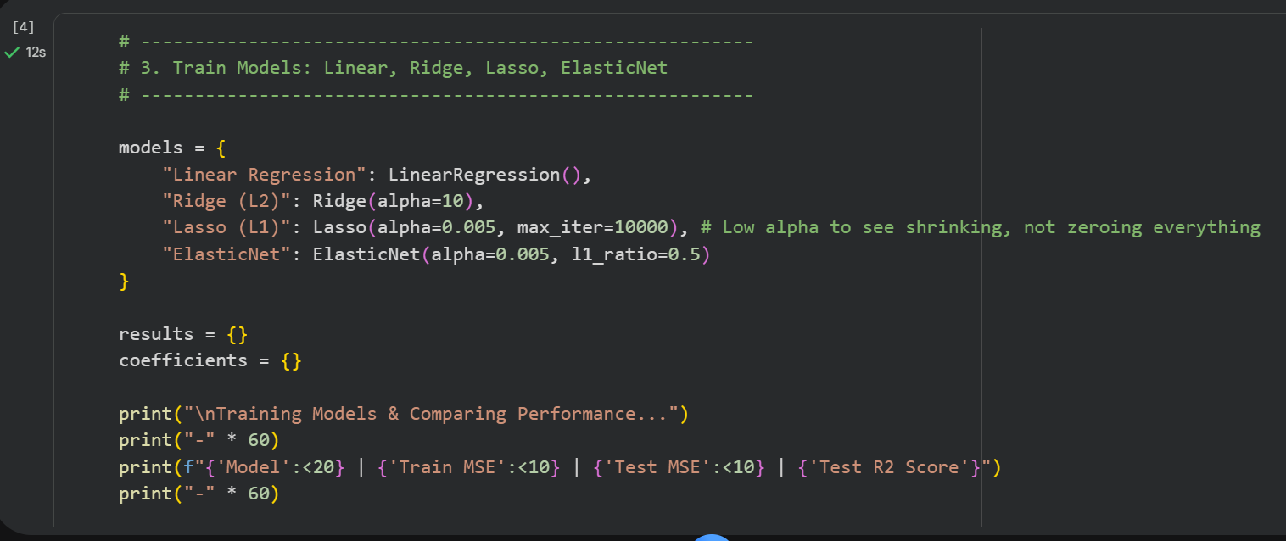
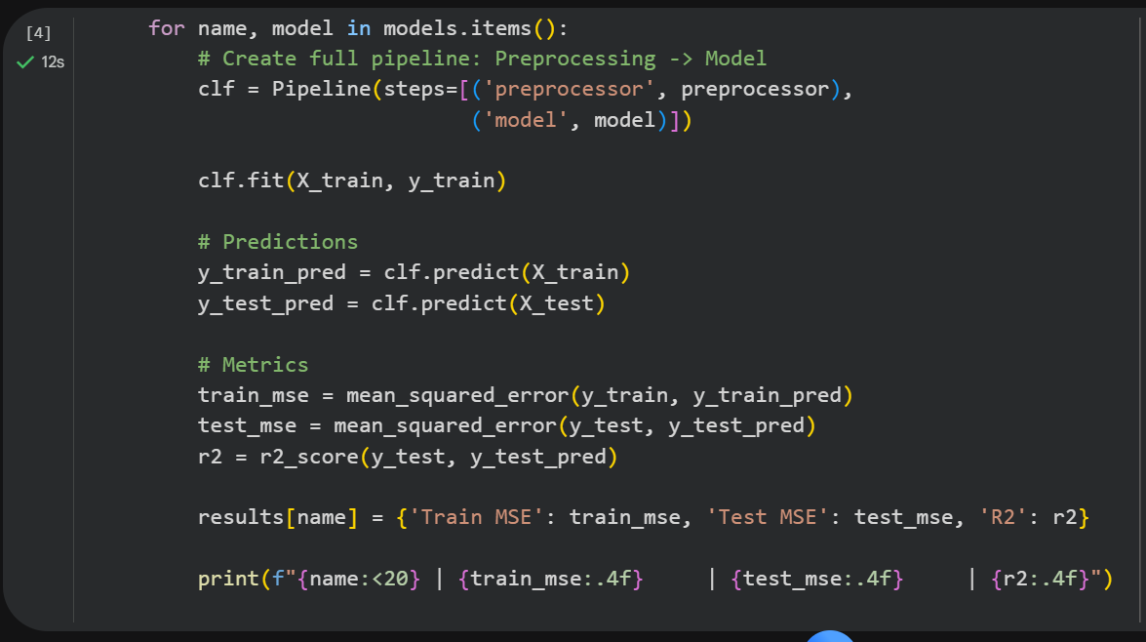
Model Training & Evaluation Comparision

Slide 9
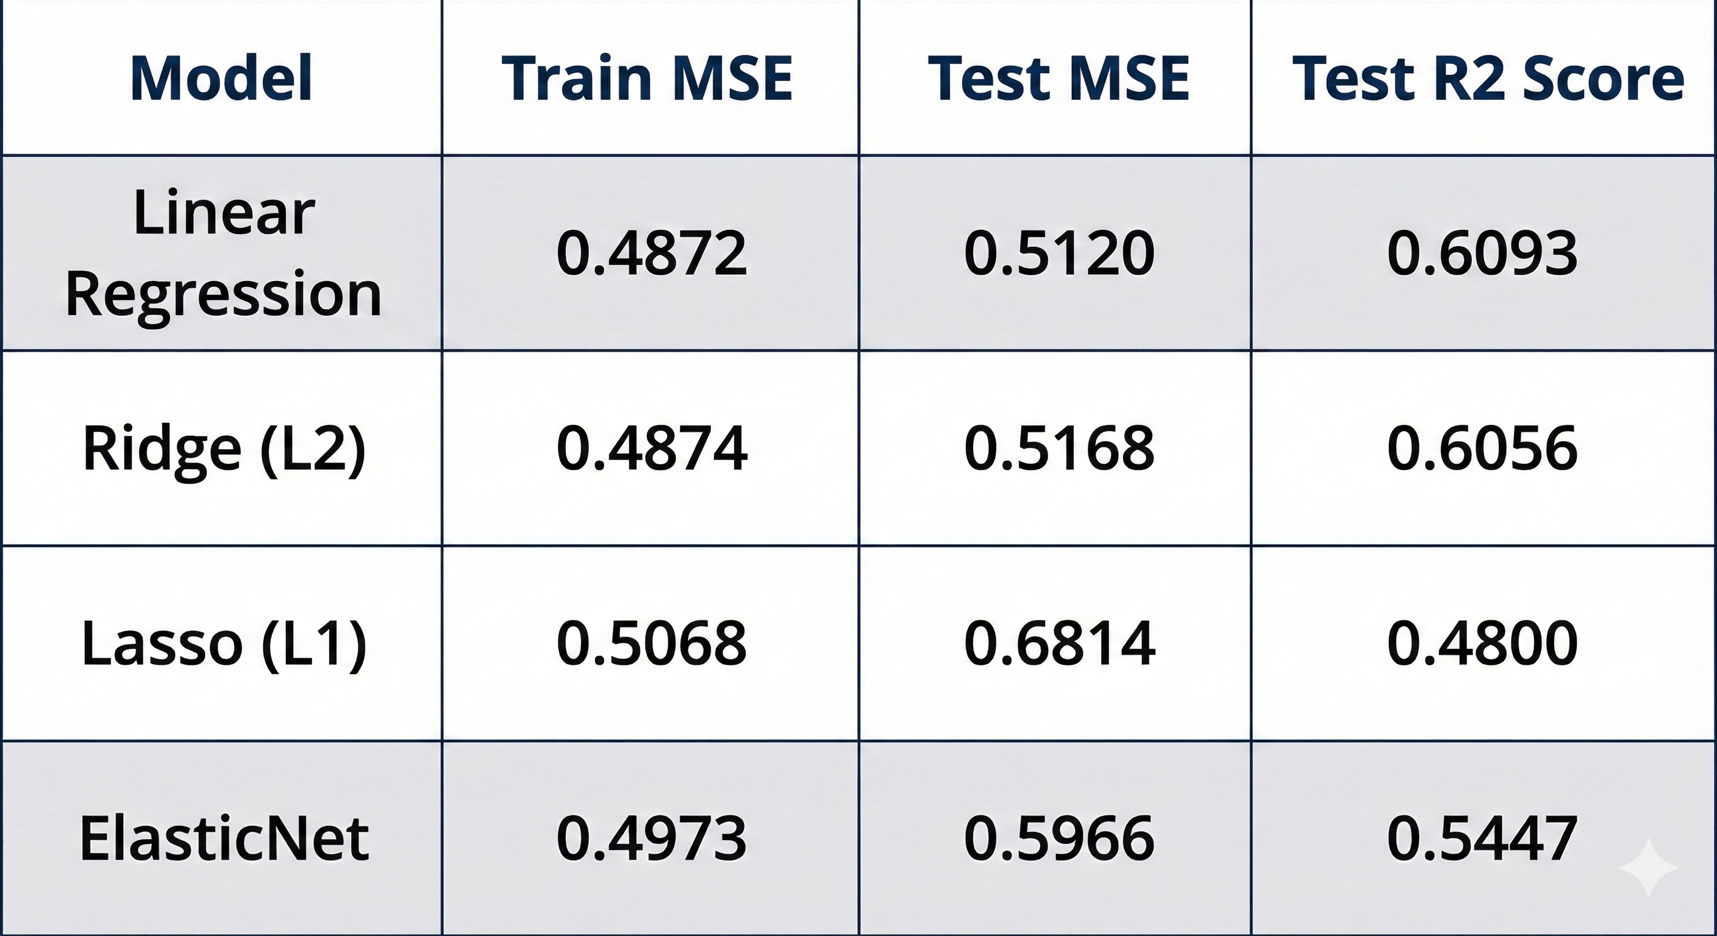
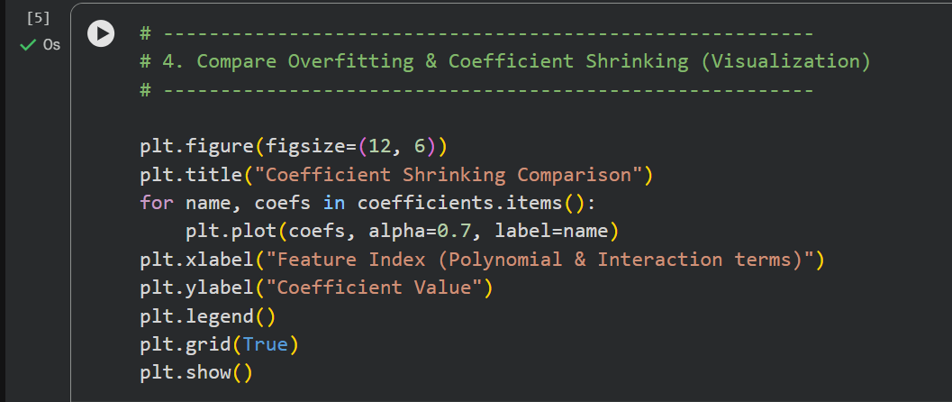

Slide 10
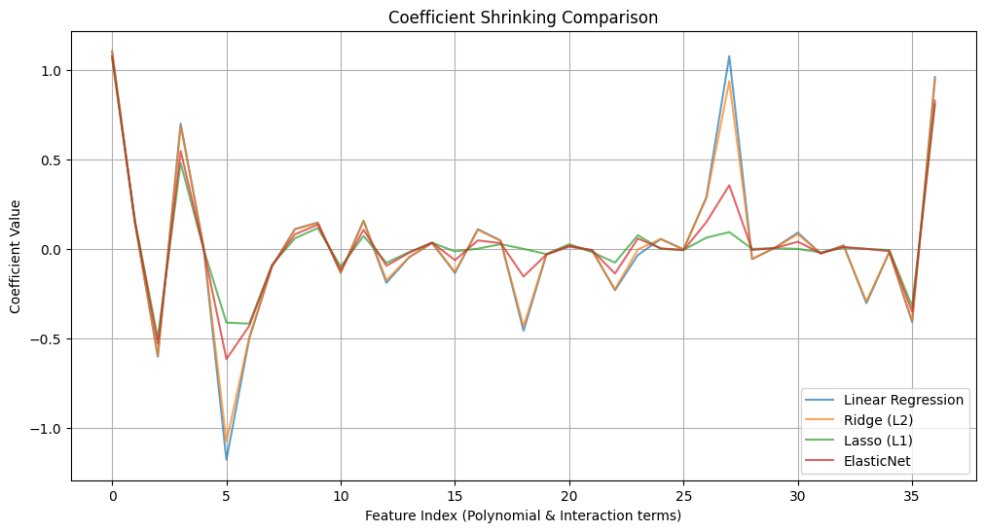

Slide 11
Final Conclusion
Best Model: Standard Linear Regression.
Reason: High generalization score (R2 ~0.61) without overfitting.
Recommendation: Use Linear Regression for this specific feature set.

